Slide 1
User Analytics in the Telecommunication Industry - Overview
Analyzing a telecommunication dataset that contains useful information about the customers & their activities on the network
NAME: PANKAJ DEVIKAR
INSTITUTION: DIGICHROME ACADEMY

Slide 2
Need of Analysis
Investors often target undervalued assets and rely on in-depth data analysis to assess a company's core business fundamentals.
Identifying profit trends plays a key role in this process, as it has previously led to significant profit increases by highlighting lucrative opportunities.
Understanding customer demographics and behavior is equally important for projecting profitability, particularly in industries like telecommunications.
The current focus is on analyzing TellCo to evaluate its growth potential and profitability in the highly competitive market.

Slide 3
Introduction
Focuses on evaluating growth potential by analyzing user behavior, engagement, and satisfaction with TellCo's services.
The analysis is intended to determine if investing in TellCo is a wise decision, and to identify areas for improvement and growth.
The language emphasizes customer experience and the quality of services rather than a direct buy/sell recommendation

Slide 4
Scope
This analysis is structured around four critical areas, each offering unique insights into TellCo's user base and overall performance:
User Activity Overview: This section provides a high-level summary of user activities, including data consumption (both upload and download), session lengths, and the total number of sessions. It highlights key usage patterns and behavior trends across TellCo’s network, showcasing the most and least active users.
User Engagement Analysis: Here, we delve into how users interact with TellCo’s services, examining the frequency of sessions, session durations, and data usage across various applications (e.g., social media, video streaming). By segmenting users based on engagement levels, we can identify highly engaged users and those at risk of churn.
User Experience Evaluation: This section focuses on assessing the technical performance of TellCo’s network and its impact on user experience. Key metrics such as TCP retransmission rates, round trip time (RTT), and throughput are analyzed to understand how network quality influences user satisfaction and to pinpoint areas where service performance may be falling short.
Customer Satisfaction Assessment: Combining insights from both engagement and experience metrics, this section evaluates overall customer satisfaction. By leveraging clustering techniques and predictive models, we identify satisfaction trends and forecast future customer retention patterns, providing a clear picture of TellCo's ability to maintain long-term customer loyalty.

Slide 5
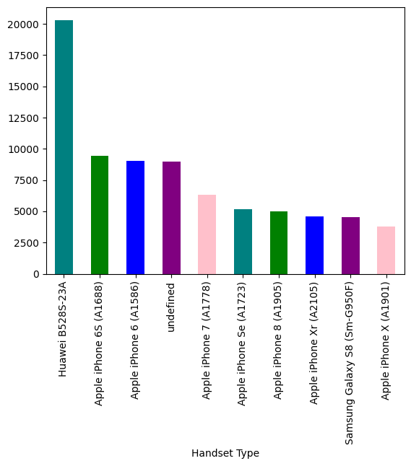
Task 1 - User Overview Analysis
Top 10 handsets used by the customers
Interpretation:
1. Most Used Device: The Huawei B528S-23A has the highest usage count, with 20,323 instances. This suggests it's a popular device among your users, likely due to its features or affordability.
2. Apple Dominance: Multiple Apple iPhone models (iPhone 6S, iPhone 6, iPhone 7, SE, 8, XR, X) appear frequently on the list, indicating that Apple devices are widely used among your user base. The iPhone 6S and iPhone 6 are the most common, with usage counts of 9,419 and 9,023 respectively.
Recommendations:
1. Focus on Popular Devices: Since Huawei B528S-23A and older iPhone models are highly used, ensure that your services or products are well-optimized for these devices.
2. Address Undefined Entries: Investigate why "undefined" appears in your data. It could indicate an issue with how you're collecting or processing data, leading to incomplete or inaccurate information.

Slide 6
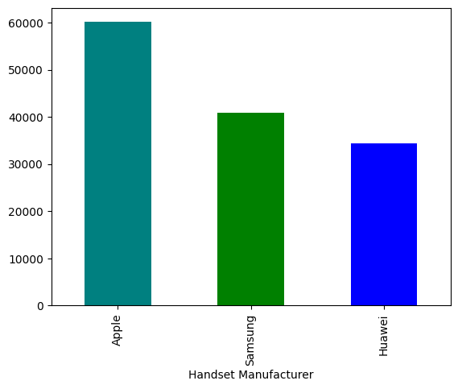
Top 3 handset manufacturers
Interpretation:
1. Apple Leads the Market: With 60,136 users, Apple is the most popular handset manufacturer among your users. This suggests that a significant portion of your user base prefers Apple devices.
2. Strong Samsung Presence: Samsung is the second most popular brand, with 40,839 users. While it's behind Apple, it's still a major player in your user base.
.
Recommendations:
1. Prioritize Apple Users: Given that Apple has the largest user base, ensure that your products, services, or apps are fully compatible with Apple devices. Consider offering promotions or features that cater specifically to iPhone users.
2. Cater to Samsung and Huawei Users: Since Samsung and Huawei together make up a large portion of your users (nearly 75,000 combined), it's essential to maintain strong support for these brands. This includes ensuring that your services work seamlessly on these devices and perhaps even offering some brand-specific features.

Slide 7
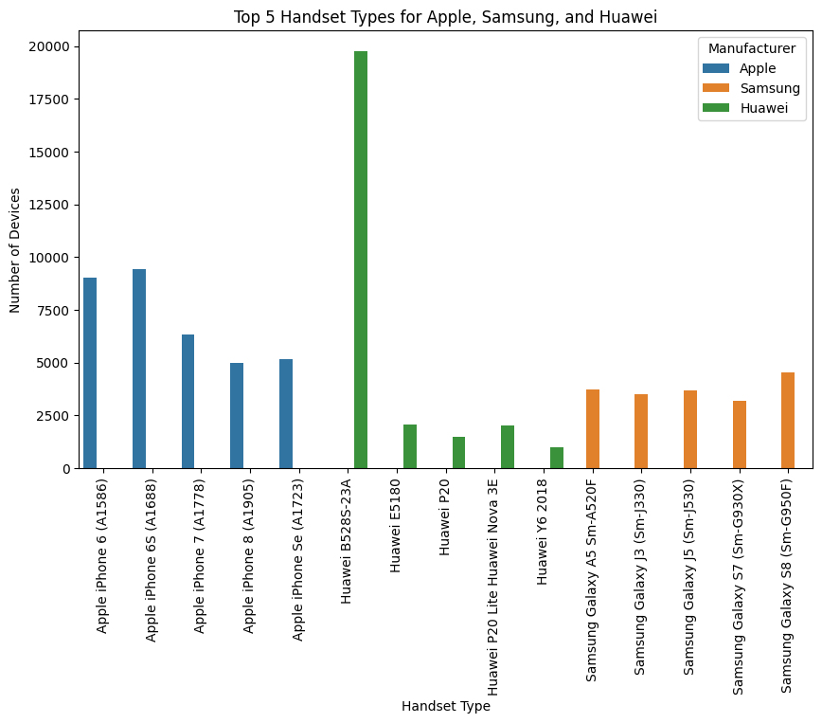
Top 5 handsets per top 3 manufacturers
Interpretation:
1. Apple has the top 5 ranked handsets among its users, with the iPhone 6S (A1688) being the most popular, followed by the iPhone 6, 7, SE, and 8.
2. The Huawei B528S-23A is the most popular Huawei device, with other popular models being the Huawei E5180, P20 Lite (Nova 3E), P20, and Y6 2018.
3. The Samsung Galaxy S8 (Sm-G950F) is the most popular Samsung device, followed by the Galaxy A5, J5, J3, and S7..
Recommendations:
1. Apple: Since the iPhone 6S and iPhone 6 are the most popular, consider marketing strategies that highlight features or apps that work particularly well on these models.
2. Huawei: Focus on the B528S-23A and E5180, possibly offering promotions or services tailored to users of these devices.
3. Samsung: The Galaxy S8 and A5 are the top choices, so ensure any Samsung-focused initiatives are aimed at users of these models.

Slide 8
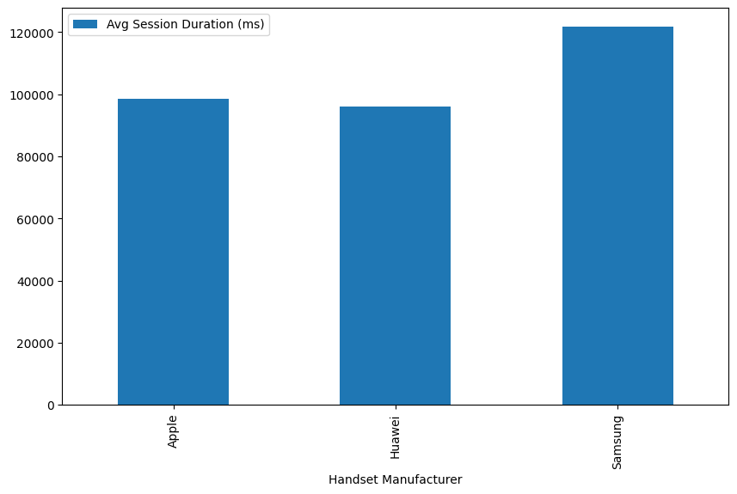
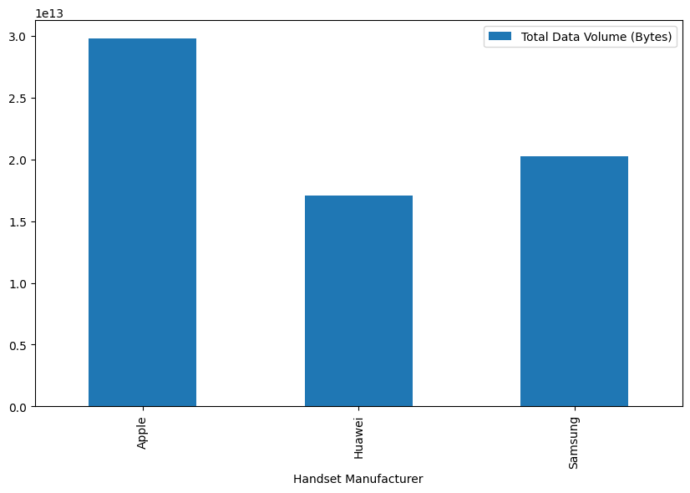
Average session duration and total data volume by manufacturers

Slide 9
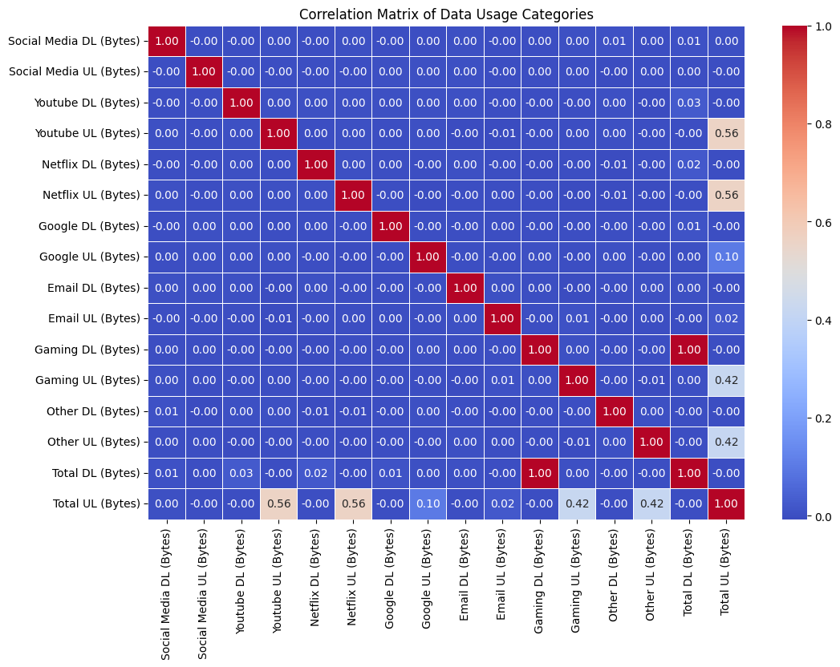
Heatmap Correlation
Interpretation:
A correlation close to 1 indicates a strong positive relationship, close to -1 indicates a strong negative relationship, and close to 0 indicates a weak relationship.

Slide 10
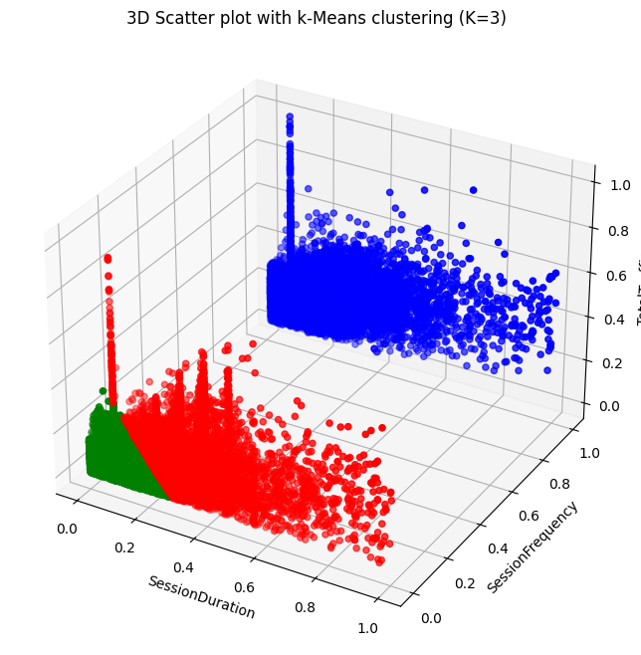
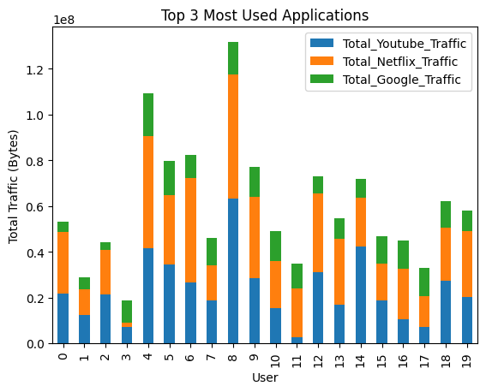
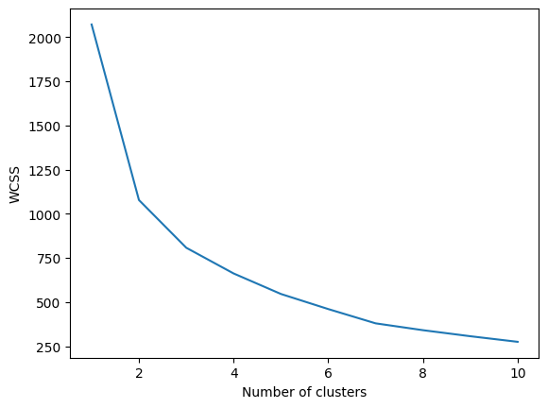
Task 2 - User Engagement analysis
Interpretation:
Distortion decreases with more clusters, but the elbow point at K = 3 or 4 suggests diminishing returns, making these likely optimal cluster counts.

Slide 11
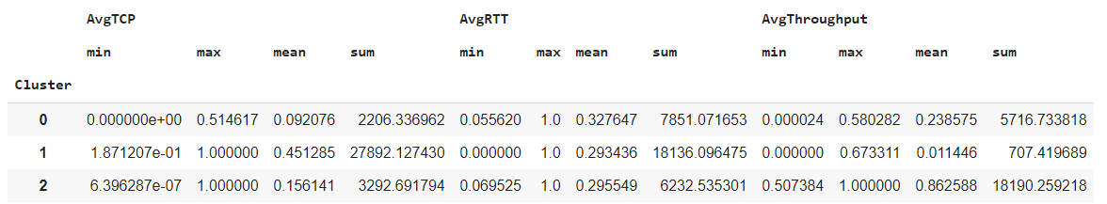
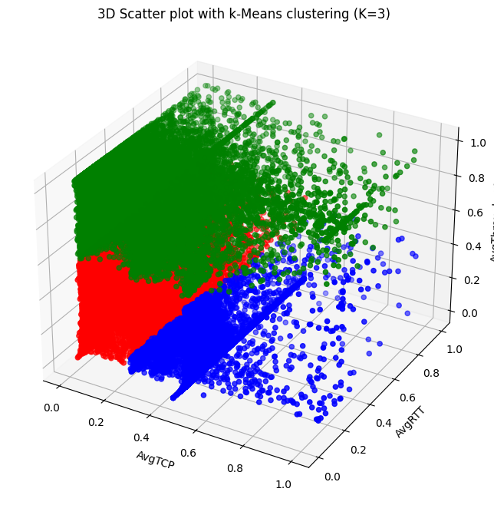
Task 3 - User Experience Analysis
Interpretation:
Cluster 2 users face the most network issues, requiring targeted optimizations, while Cluster 0 enjoys the best experience with stable throughput.
Recommendation:
Prioritize improving network conditions for Cluster 2 users and offer targeted customer support, while monitoring Cluster 1 to prevent decline in user experience.

Slide 12
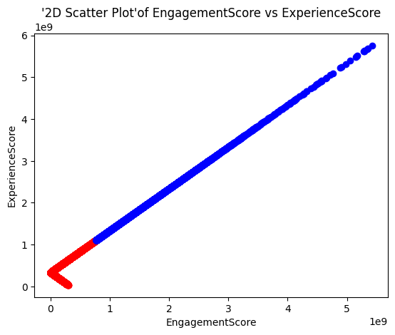
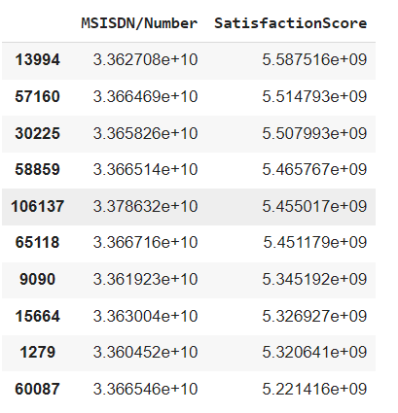


Task 4 - User Satisfaction Analysis
Inference: Cluster Comparison:
Cluster 1 has significantly higher average scores for both satisfaction and experience compared to Cluster 0. This suggests that users in Cluster 1 generally report higher levels of satisfaction and experience compared to those in Cluster 0.
Insights on User Segments:
Users in Cluster 1 might be more engaged or have better experiences with your product or service, leading to higher average satisfaction and experience scores. Cluster 0 could represent a segment that is less satisfied or experiences more issues compared to Cluster 1. This could indicate areas for improvement in your product or service for this segment.

Slide 13
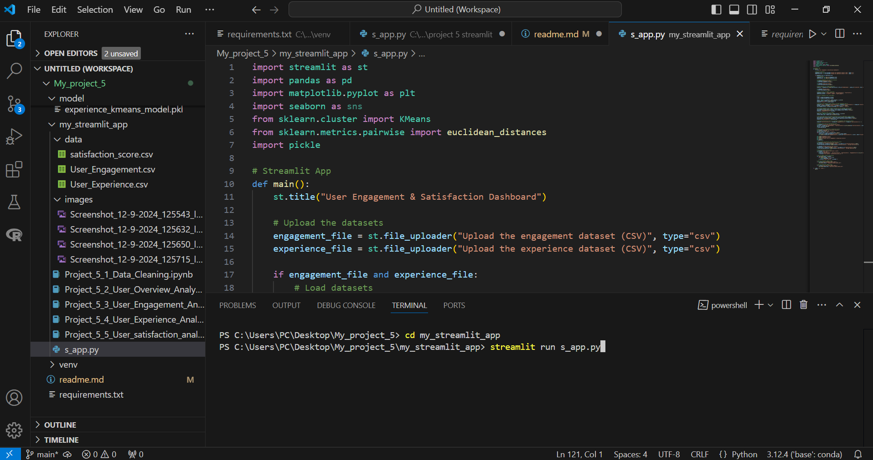
Project Implementation

Slide 14
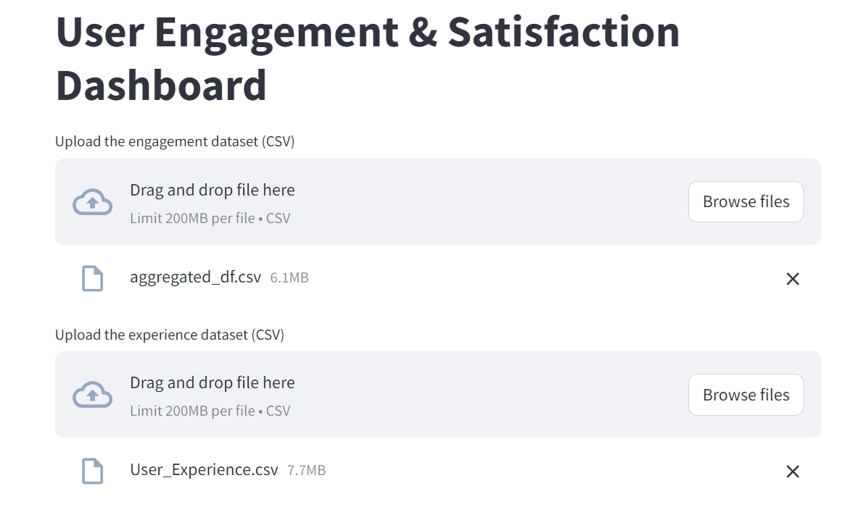
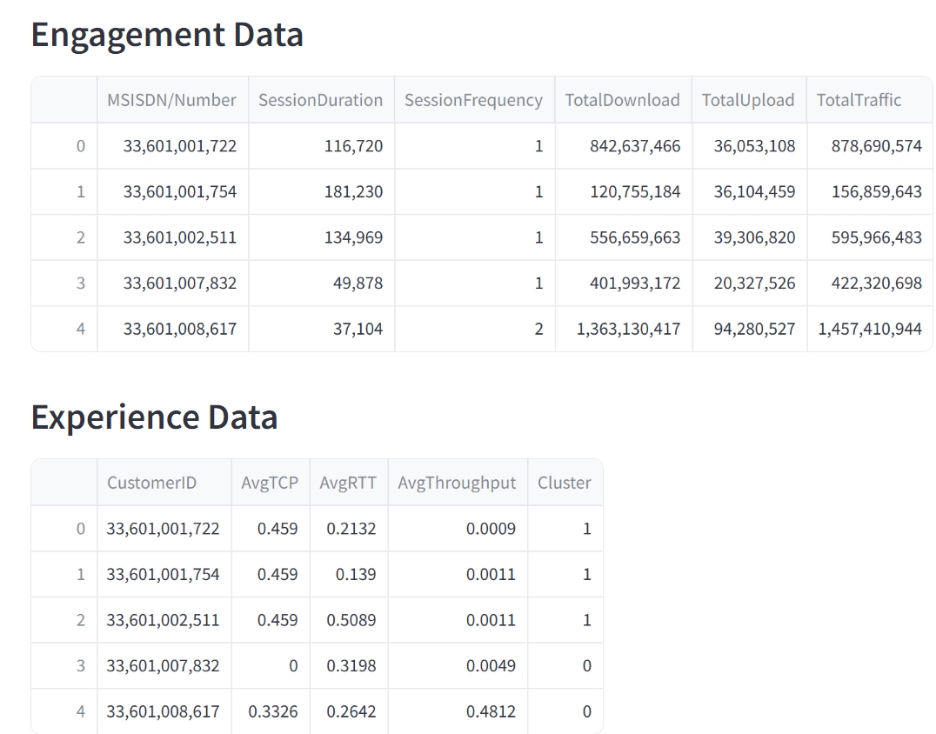
Streamlit app

Slide 15
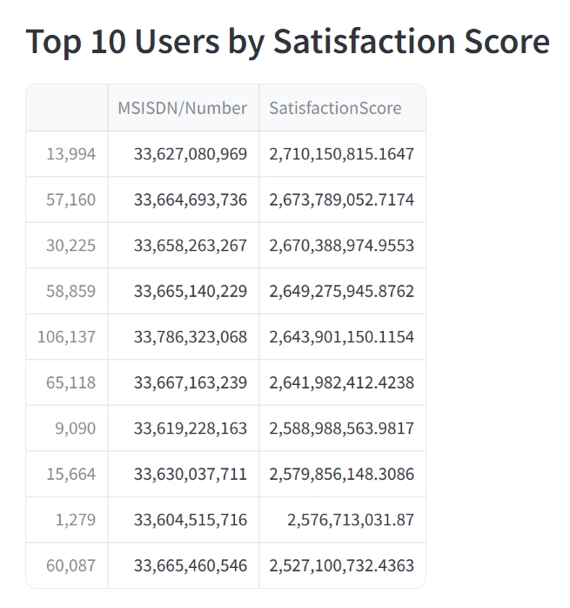
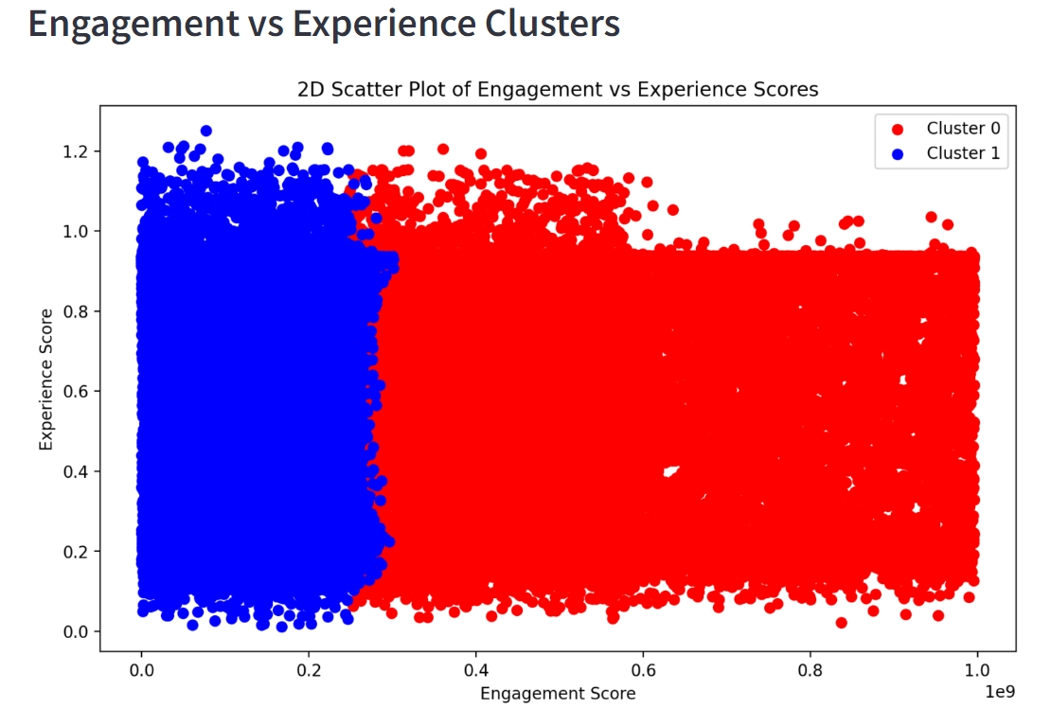
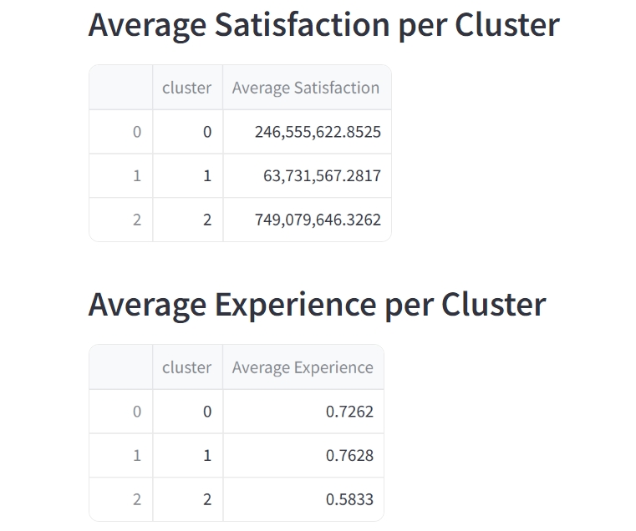

Slide 16
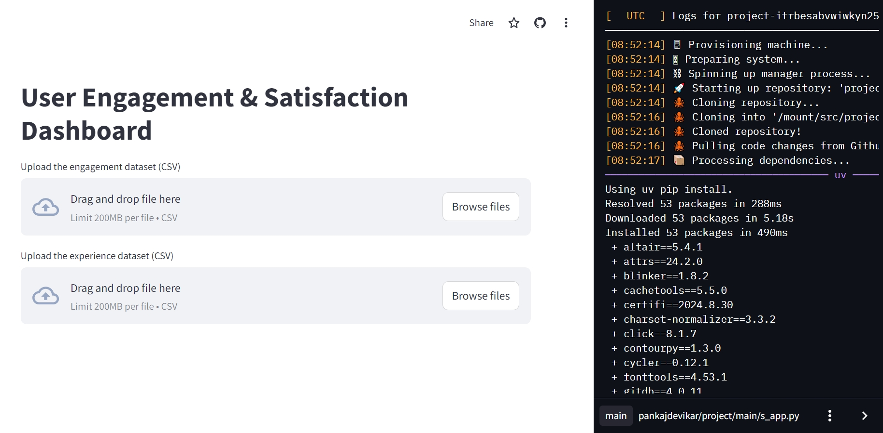
Deployment in Streamlit

Slide 17
Interpretation and Recommendation
User Overview:
Interpretation: Highlights overall usage patterns, identifying both the most frequent and least frequent users in terms of data consumption, session duration, and activity levels.
Recommendation: Implement retention strategies for high-usage customers by offering loyalty rewards or premium services. For less active users, explore incentives or tailored offers to increase engagement and identify potential service issues they may be facing.
User Engagement:
Interpretation: Examines how users interact with TellCo’s services, such as usage across different applications, session frequency, and duration, uncovering insights into their engagement levels.
Recommendation: Increase engagement by optimizing the most-used services and features. For users showing signs of churn, develop personalized outreach efforts with targeted discounts or offers to re-engage them.
User Experience:
Interpretation: Evaluates the impact of network performance on user experience through technical metrics like TCP retransmission rates, RTT, and throughput, providing insights into service reliability.
Recommendation: Invest in improving network infrastructure to address performance bottlenecks and reduce disruptions. Prioritize regions or customer segments experiencing the most technical issues to enhance overall satisfaction.
User Satisfaction:
Interpretation: Assesses customer satisfaction by analyzing their engagement and service experience, helping to gauge loyalty and the likelihood of retention.
Recommendation: Leverage satisfaction insights to optimize customer support, improve product offerings, and design personalized experiences that promote long-term customer retention and brand loyalty.

Slide 18
THANKYOU

